Slide 1



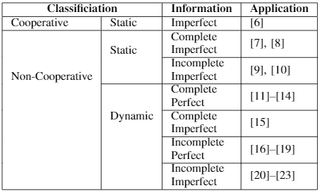




Cryptography, Security, and Privacy Research Group
Game Theory Applications within Cyber Security
Erhan Tezcan 0070881 – Mandana Bagheri Marzijarani 0074025
Problem: Complex Decision-Making Strategies of Attacker & Defender
Solution: Security Setting modeled as a Game and studied under Game Theory
The number of incidents in cyberspace is constantly rising. Most defense methods in practice are ad hoc, which are often destined to be circumvented by more clever and novel attacks.
Model the attack setting as a game (or many games)
Formally define the players and payoffs
Prove and try to find the equilibrium points
Create strategies
Payoffs
 | D | ¬D
A | 0,-2 | -5,5
¬A | -3,0 | 1,0
Attacker
Series of attacks & defenses
Complex Decision Making
Adaptive Strategies
…
Defender
The Attacker (a group of entities such as botnet / a human / a malware / …) tries to engage in malicious activity.
The Defender (IDS / anti-virus / system administrator / security expert / …) tries to prevent that from happening.
More advanced attacks result in a series of actions, based on complex decision making and dynamic interactions. Static defense mechanisms against known attacks are always vulnerable to such dynamic and novel attacks.
Game theory deals with optimal decision making of independent players. Complex attack-and-defend schemes can be modeled and studied under game theory.
A: Attack ¬ A: No Attack D: Defense ¬ D: No Defense
We provide classification of games and survey its applications. We focus on 3 particular studies:
An intrusion detection network resource allocation model
A detection manipulation game
A moving target defense for intrusion detection system placement on cloud systems
We make remarks on similarities between cryptographical assumptions & reduction proofs and formal definitions of game models & existence of equilibrium points in them.
COMP 434/534 COMPUTER AND NETWORK SECURITY
Notes:
1
Your poster needs to be legible, nice-looking, and must summarize the most important aspects of your problem and solution, in an eye-catching manner. Use the template that is provided.

